Slide 1
Term Deposit Subscription Prediction

Slide 2

Hello!
I’m Priscilla Widjaja
(JCDS 09 - Jakarta)

Slide 3

1. BUSINESS PROBLEM
Abstract

Slide 4

BANK MARKETING
Abstract
The data is related with direct marketing campaigns (phone calls) of a Portuguese banking institution. The classification goal is to predict if the client will subscribe a term deposit (variable y).
Problem
Often, more than one contact to the same client was required, in order to access if the product (bank term deposit) would be ('yes') or not ('no') subscribed.

Slide 5
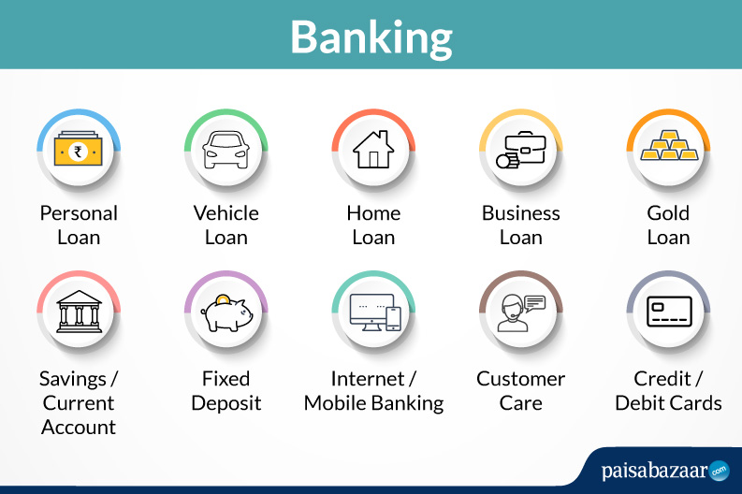
TERM DEPOSIT
Created by deposits a certain amount of money in the bank for a preliminary fixed period of time.
The bank is obliged to pay out certain interest at a definite time.
With a fixed period for which the interest rate agreed between the bank and the client is valid.
The interest rate is higher compared to that on a current account.
The interest rate usually increases when the term of the deposit is enlarged.
If the deposit is drawn earlier than the agreed period, the client usually loses the interest or a part of it.

Slide 6
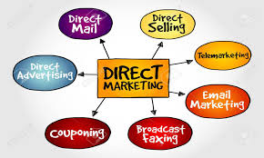
TELEMARKETING
Contacting, qualifying, and canvassing prospective customers using telecommunications devices such as telephone, fax, and internet.

Slide 7
ADVANTAGES AND DISADVANTAGES OF TELEMARKETING
Advantages
Allows to immediately gauge customer's level of interest.
Provide a more interactive and personal sale service.
Create an immediate rapport with your customers.
Explain technical issues more clearly.
Sell from a distance to increase your sales territory.
Achieve results that are measurable.
Disadvantages
Customer lists can be very costly.
Telemarketing has a negative image that could damage your business' reputation - if carried out poorly.
Training staff can be time-consuming and costly.
Often, more than one contact to the same client was required.

Slide 8

2. ATTRIBUTE INFORMATION
Dataset : http://archive.ics.uci.edu/ml/datasets/Bank+Marketing#

Slide 9

BANK CLIENT DATA
Category | Descriptions | Data Type | Data Values
Age |  | Numeric
Job | Type of Job | Categorical | 'admin.', 'blue-collar', 'entrepreneur', 'housemaid', 'management', 'retired', 'self-employed', 'services', 'student', 'technician', 'unemployed', 'unknown'
Marital | Marital Status | Categorical | 'divorced', 'married', 'single', 'unknown’ ; Note: 'divorced' means divorced or widowed

Slide 10
BANK CLIENT DATA
Columns | Descriptions | Data Type | Data Values
Education |  | Categorical | 'basic.4y', 'basic.6y', 'basic.9y', 'high.school', 'illiterate', 'professional.course', 'university.degree', 'unknown'
Default | has credit in default? | Categorical | 'no', 'yes', 'unknown'
Housing | has housing loan? | Categorical | 'no', 'yes', 'unknown'
Loan | has personal loan? | Categorical | 'no', 'yes', 'unknown'

Slide 11
RELATED WITH THE LAST CONTACT OF THE CURRENT CAMPAIGN
Columns | Descriptions | Data Type | Data Values
Contact | Contact Communication Type | Categorical | 'cellular','telephone'
Month | Last Contact Month of Year | Categorical | 'jan', 'feb', 'mar', …, 'nov', 'dec'
Day of Week | Last Contact Day of The Week | Categorical | 'mon','tue','wed','thu','fri'
Duration | Last Contact Duration | Numeric | Seconds
Important Note : Duration highly affects the output target (e.g., if duration=0 then y='no'). Yet, the duration is not known before a call is performed. Also, after the end of the call y is obviously known. Thus, this input should only be included for benchmark purposes and should be discarded if the intention is to have a realistic predictive model.

Slide 12
OTHER ATTRIBUTES
Columns | Descriptions | Data Type | Data Values
Campaign | Number of contacts performed during this campaign and for this client | Numeric | Includes last contact
Pdays | Number of days that passed by after the client was last contacted from a previous campaign | Numeric | 999 means client was not previously contacted
Previous | Number of contacts performed before this campaign and for this client | Numeric
Poutcome | Outcome of the previous marketing campaign | Categorical | 'failure','nonexistent’, 'success'

Slide 13
SOCIAL AND ECONOMIC CONTEXT ATTRIBUTES
Columns | Descriptions | Data Type
Emp.var.rate | Employment Variation Rate - Quarterly Indicator | Numeric
Cons.price.idx | Consumer Price Index - Monthly Indicator | Numeric
Cons.conf.idx | Consumer Confidence Index - Monthly Indicator | Numeric
Euribor3m | Euribor 3 Month Rate - Daily Indicator | Numeric
Nr.employed | Number of Employees - Quarterly Indicator | Numeric

Slide 14
OUTPUT VARIABLE (DESIRED TARGET)
Column | Descriptions | Data Type | Data Values
y | Has the client subscribed a term deposit? | Binary | 'yes', 'no'

Slide 15
3. MACHINE LEARNING
Supervised : Classification

Slide 16

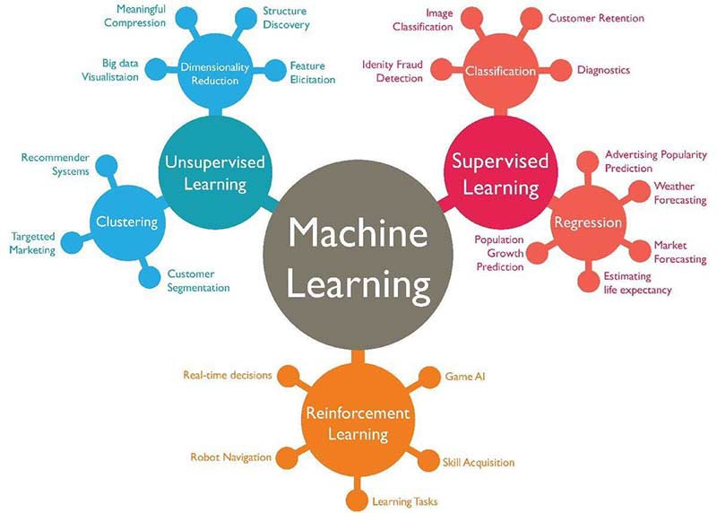
CLASSIFICATION
The process of predicting class or category from observed values or given data points.
Targets are also provided along with the input data set.
Mathematically, it is the task of approximating a mapping function (f) from input variables (X) to output variables (Y).

Slide 17
ALGORITHMS
Logistic Regression
Used when the value of the target variable is categorical in nature. The data has binary output, so when it belongs to one class or another, or is either a 0 or 1.
Random Forest
Creates decision trees on data samples. Gets the prediction from each of them. Selects the best solution by means of voting.
K Nearest Neighbors
An algorithm that stores all available cases and classifies new cases based on a similarity measure (e.g., distance functions).

Slide 18
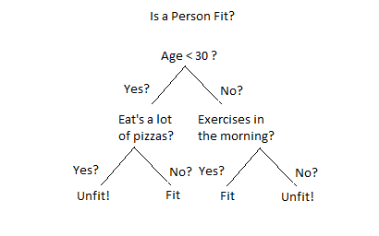
DECISION TREE CLASSIFIER
Builds models in the form of a tree structure. It breaks down a data set into smaller and smaller subsets. The final result is a tree with decision nodes and leaf nodes.
A decision node has two or more branches. Leaf node represents a classification or decision.
The topmost decision node in a tree which corresponds to the best predictor called root node.

Slide 19
4. PROBLEM SOLVING
Building Model

Slide 20

Step by Step
Load Dataset
Handling Missing Values
Handling Outliers
Encoding
Scaling
Features Selection
Splitting Dataset
Handling Imbalance Target
Building Machine Learning
Hyperparameter Tuning
Evaluating Model
Saving Model
Using Model

Slide 21
5. CONCLUSION
Evaluation : Decision Tree Classifier

Slide 22

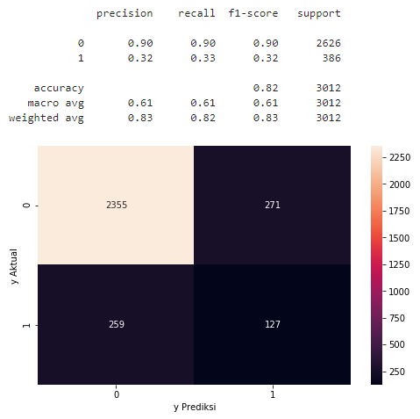
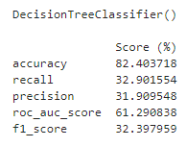
Before Hyperparameter Tuning

Slide 23
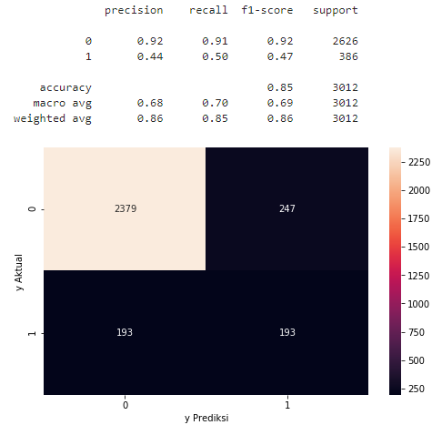
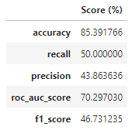
After Hyperparameter Tuning

Slide 24

Thank You
Any questions?
You can find me at roselinapriscilla.widjaja@gmail.com .

